Slide 1
CAPITAL MARKETS Lecture 1: risk & return overview
Chapter 1
Professor Droussiotis

Slide 2
What’s This?

Slide 3
EXIT
Expected Value Line Growth (Return)
Risk-Free Rate
ENTRY
Initial
Investment

Slide 4
Expected Value Line Growth (Return)
EXIT
Risk Premium
Risk-Free Rate
ENTRY
Initial
Investment

Slide 5
Expected Value Line Growth (Return)
EXIT
Risk (Volatility)
Risk Premium
Risk-Free Rate
ENTRY
Initial
Investment

Slide 6
The Study of Finance
Buying Stocks / Buying Bonds
Buying Assets / Equipment
Starting a New Project
Buying a Company
Starting a new Company
3 FACTORS BEFORE YOU INVEST
Measure Expected Return
Quantify Risk
Set Time (Exit)

Slide 7
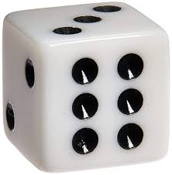
The Study of Finance
3 FACTORS BEFORE YOU INVEST
Measure Expected Return
Quantify Risk
Set Time (Exit)
Game: Tossing a Coin to win $6 (Payoff):
Measure Expected Return: $6
Quantify Risk: 50/50 win/loss
Time: in 2 seconds
How much to Invest?
$3 - mathematically using probability theory is (50% x $6) + (50% x $0) = $3 + 0 = $3
Game: Tossing one dice to win $6 (Payoff):
Measure Expected Return: $6
Quantify Risk: 1/6 to win, 5/6 to lose
Time: in 2 seconds
How much to Invest?
$1 - mathematically using probability theory is (1/6 x $6) + (5/6 x $0) =
$1 + 0 = $1

Slide 8
The Study of Finance
Risks that are pushing the Value Line down
FIELDS OF FINACE
Corporate Finance
Investment Analysis
Credit Analysis
EXIT
Risk (Volatility)
Expected Value Line Growth (Return)
Finance Strategies to Keep the Value Line Up
Initial
Investment
ENTRY
3 FACTORS BEFORE YOU INVEST
Measure Expected Return
Quantify Risk
Set Time (Exit)

Slide 9
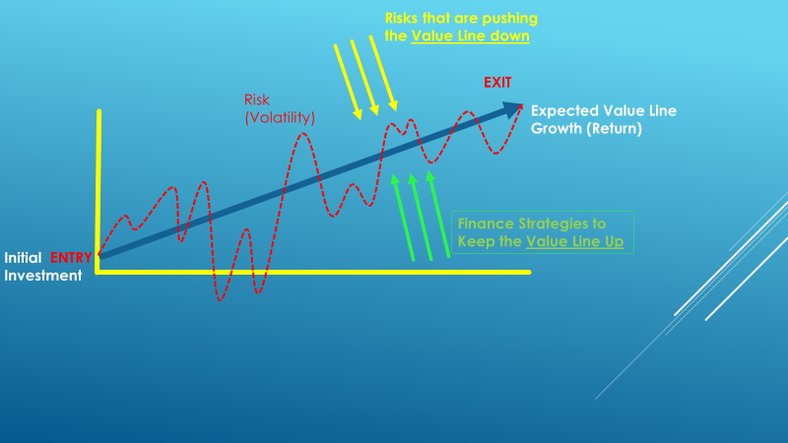
The Study of Finance
Corporate Finance
Risks that are pushing the Value Line Down:
Economy
Competition
Government
Disasters
Other Systemic/Firm Specific Risks
Strategies to Keep the Value Line Up
Operating Strategies
Transactional Strategies
Financing Strategies
Social Responsibility

Slide 10
The Study of Finance
Investments
Risks that is pushing the Value Line Down:
Economy and Markets
Government & Regulation
Liquidity
Other Systemic/Firm and Asset Class Specific Risks
Strategies to Keep the Value Line Up
Allocation/Diversification Strategies
Hedging Strategies (Using Derivatives)

Slide 11
The Study of Finance
Credit Analysis
Risks that is pushing the Value Line Down:
Economy
Government
Other Systemic/Firm and Asset Class Specific Risks
Strategies to Keep the Value Line Up
Loan / Bond Structure
Debt Capacity Analysis

Slide 12
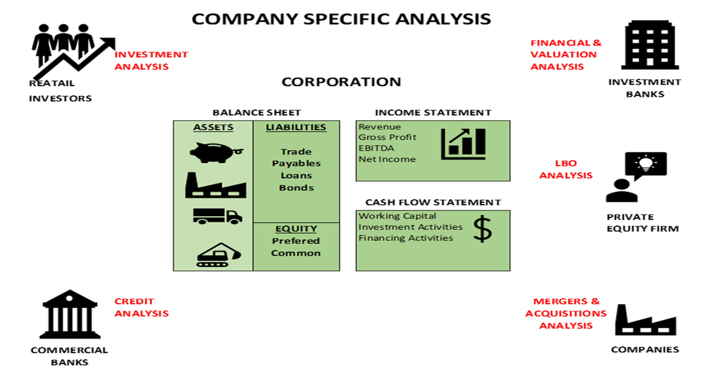
The Study of Finance
Finance, Investments and Credit
Fundamental Analysis :
Understanding Financial Statements
Build Projections
Corporate Valuations
Transaction / Debt Capacity Analysis
Technical Analysis
Stock movements, Standard Deviation
Comparative Analysis/ Regression Analysis and Correlation
Portfolio Analysis measurements CAPM, Sharpe Ratio, Beta, Alpha,
Behavioral Analysis
ASSET CLASS:
EQUITY
BONDS
DERIVATIVES

Slide 13
Chapter 1-Fundamental Concepts in finance
Time Value of Money
FV = PV ${\left(1+i\right)}^{t}$ ,
$PV=\frac{FV}{{\left(1+i\right)}^{t}}$
$i$ = $({\frac{FV}{PV})}^{\frac{1}{t}}$ – 1
$t$ = $\frac{ln (\frac{FV}{PV})}{ln⁡(1+i)}$
FVA = CF + CF (1+i) + CF (1+i) (1+i) …… FVA = CF ( $\frac{{(1+i)}^{t}−1}{i} )$
PVA = $\frac{CF}{{(1+i)}^{1}}+ \frac{CF}{{(1+i)}^{2}}$ + $\frac{CF}{{(1+i)}^{3}}$ +…..+ $\frac{CF}{{(1+i)}^{n}}$…… PVA = CF $\left[\frac{1−\frac{1}{{\left(1+i\right)}^{t}}}{i}\right]$
PV = $\frac{{CF}_{1}}{{(1+i)}^{1}}+ \frac{{CF}_{2}}{{(1+i)}^{2}}+\frac{{CF}_{3}}{{(1+i)}^{3}}+…\frac{{CF}_{t}}{{\left(1+i\right)}^{t}} …. PV= \sum{\frac{{CF}_{t}}{{(1+i)}^{t}}}$
Excel formulas for calculating all five variables including the present value, future value, rate of return, time and cash flows or payments (represent set additional payments received during the investment):
= PV (rate, years, payment, future value) or =pv(rate,nper,pmt,fv)
=FV (rate, years, payment, -present value) or =fv(rate,nper,pmt,pv)
=Rate (years, payment, - present value, future value) or =rate(nper,pmt,pv,fv)
=Nper (rate, payment, - present value, future value) or =nper(rate,pmt,pv,fv)
=Pmt (rate, years, -present value, future value) or =pmt(rate,nper,pv,fv)

Slide 14
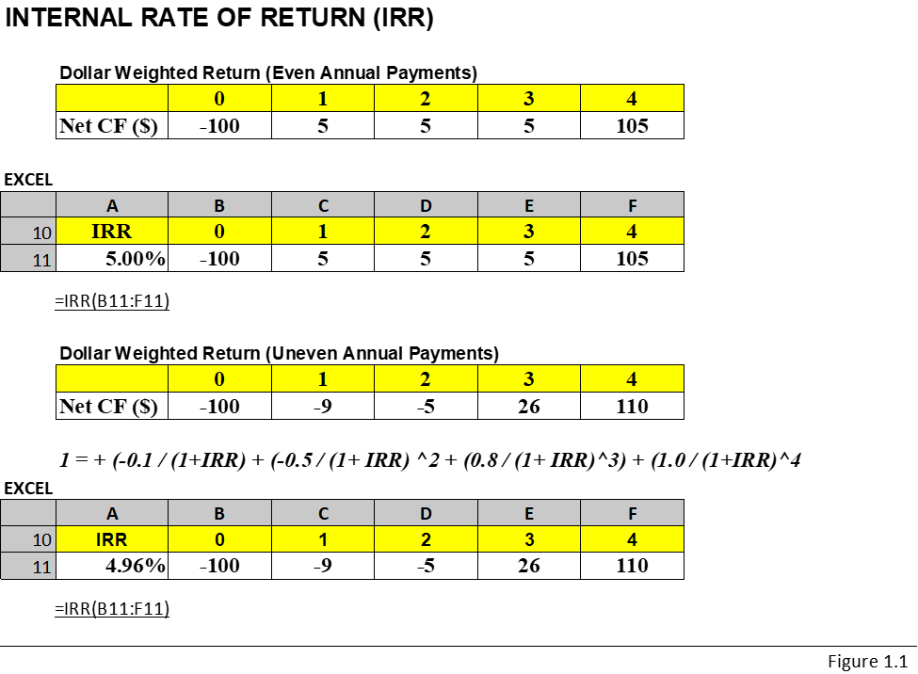
Chapter 1-Fundamental Concepts in finance
Rates of Return
HPR = $\frac{CF}{I}$
IRR

Slide 15
Measuring Return and Return Expectation
Before you invest your money in any securities or any businesses, it’s extremely important to consider and must measure the following four factors:
Return expectation
Risk
Allocation
Time

Slide 17
LEARNING OBJECTIVES
After reading this chapter, students will be able to do the following:
• Understand the component that make time value of money (TVM) including the calculations of present value (PV), future value (FV), interest rate (i) and time (t) for a one-time investment, annuity or uneven cash receipts.
• Compute various measures to calculate the historical and expected returns on many asset classes such as equities and bonds
• Quantify the risk on these asset classes by calculating the variance and standard deviation
• Understand how to measure past performances of stocks and bonds using both historical analysis and scenario analysis to determine the expected risk/return going forward
• Construct a portfolio of investments consisting of stocks, bonds, and risk-free investments such as cash, money market, or treasury bills and the impact of diversification
• Understand portfolio optimization and efficiency based on asset allocation between stock, bonds, and cash

