Slide 1

Time Value of Money
An Overview

Slide 2
Time value concepts
Present Value – The amount an investment is worth today.
Future Value – The amount an investment is worth after one or more periods.
Interest rate – “exchange rate” between money today and money tomorrow
Discount rate
Cost of capital
Opportunity cost of capital
Required return

Slide 3
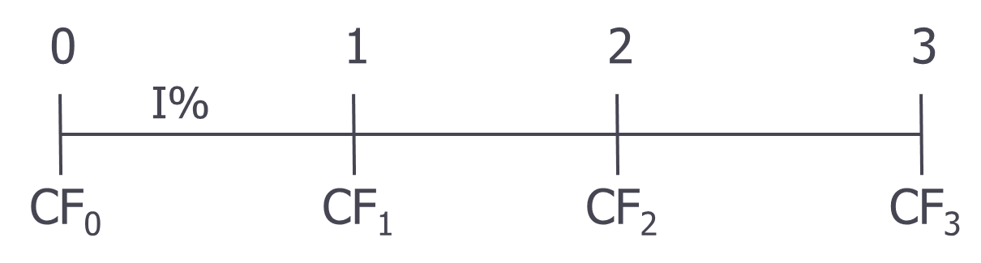
Timelines
Show the timing of cash flows.
Tick marks occur at the end of each period.
Each tick mark corresponds to the end of one time period and the beginning of the next one.

Slide 4
Simple vs. Compound Interest

Slide 5

Simple Interest
FV with simple interest
  The $1,000 investment accrues $50 each year for each of two years, So in 2 years you have:
  1000 + 50 + 50 = 1,100

Slide 6
Simple Interest
FV with simple interest
  The $1,000 investment accrues $50 each year for each of two years, So in 2 years you have:
  Year 0 = (1,000)
  Year 1= 1000 + 50 = 1,050
  Year 2 = 1000 + 50 + 50 = 1,100

Slide 7
Compound Interest
What is the future value of $1,000 after 2 years if the interest rate is 5% compounded annually?
1000 + 50 = 1,050
1,050 (1.05) =

Slide 8
Compound Interest
What is the future value of $1,000 after 3 years if the interest rate is 5% compounded annually?

Slide 9
FV: Formula Methods
After 1 year:
  FV₁ = PV(1 + r) = $1,000(1.05) = $1,050.00
After 2 years:
  FV₂ = $1,050.00(1.05) = $1,102.50 or FV₂ = PV(1 + r)² = $1,000(1.05)² = $1,102.50
After 3 years:
  FV₃ = 1,102.50(1.05) = $1,157.63 FV₃ = PV(1 + r)³ = $1,000(1.05)³ = $1,157.63
After t years (general case):
  FV_{t} = PV(1 + r)^{t}

Slide 10
Future Values: General Formula
FV = PV(1 + r)^{t}
  FV = future value
  PV = present value
  r = period interest rate, expressed as a decimal
  t = number of periods (time)
Interest factor = (1 + r)^{t}
To find future values

Slide 11
Future Values – Example 2
Suppose you invest the $1,000 at an interest rate of 5% for 10 years. How much would you have assuming compound interest?
FV = PV(1 + r)^{t}
^{1000 (1+.05)^10 = $1,628.89}

Slide 12
Future Value – Example 3
Suppose a relative of yours deposited $10 at 5% interest into a savings account 200 years ago. How much would the investment be worth today with simple interest? With compound interest? What is the difference?
Simple 10 + 10 (0.5) (200) = 110
Compound FV = 10 (1+1.05) ^ 200 = 172,925.81

Slide 13
FV: Using Excel’s Financial Technology
Type the formula
Use a dialogue box
  Click on Formulas > Financial > FV.
  Fill in the Rate, number of periods (Nper), periodic payments (Pmt), and present value (Pv). Click OK.
Type the function
  =FV(rate, nper, pmt, pv, type)

Slide 14
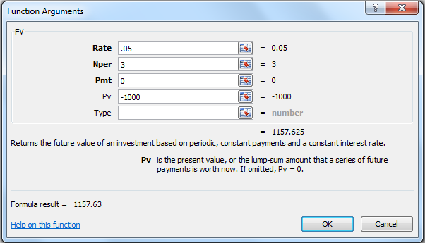
FV: Excel Dialogue Box Technology
If you invest $1000 for 5% per year how much money will you have in 3 years?

Slide 15
FV: Excel Formula

Slide 16
Future Value – one more example
A company currently has profits of $3 million dollars. If profits increase 4% each year, how much profit will the company earn in 10 years?

Slide 17
Future Value – one more example
A company currently has profits of $3 million dollars. If profits increase 4% each year, how much profit will the company earn in 10 years?
3mm , i=0.04 t = 10
FV = 3 (1.04) ^ 10

Slide 18
Future Value – another example
You borrow $10,000 in student loans your freshman year at an annual interest rate of 6.2% per year. If you have a grace year and don’t have to start paying back the loan until after you graduate, how much money do you owe 5 years later?

Slide 19
Future Value – another example
You borrow $10,000 in student loans your freshman year at an annual interest rate of 6.2% per year. If you have a grace year and don’t have to start paying back the loan until after you graduate, how much money do you owe 5 years later?
PV – 10,000, i=0.62, t= 5
10,000 * (1.062) ^5 = 13,508.98

Slide 20
Future Value – One more example
If a stock which is currently worth $32 is expected to have return 8% annually, how much will it be worth in 5 years?

Slide 21
Future Value – One more example
If a stock which is currently worth $32 is expected to have return 8% annually, how much will it be worth in 5 years?
Pv = 32
I = 8.0%
47.02

Slide 22
Present Value
The amount an investment is worth today (now, at time 0).
Finding the PV of a cash flow or series of cash flows is called discounting.
The value of cash flows in today’s purchasing power.
0
1
2
3
10%
PV = ?
100

Slide 23
Present Values
We can use the future value formula to find the present value.
  FV = PV(1 + r)^{t}
  Rearrange to solve for PV = FV / (1 + r)^{t}
To find present values

Slide 24
PV: The Formula Method
How much money must you invest today if you can earn 7% and you would like to have $5,000 in 10 years.

Slide 25
PV: The Formula Method
How much money must you invest today if you can earn 7% and you would like to have $5,000 in 10 years.
75.13

Slide 26
Present Values – Example 2
Suppose when you were born, your parents wanted to begin saving for your college education and they estimated that after 17 years you would need $150,000. If they felt confident that they could earn 8% per year, how much did they need to invest when you were born?

Slide 27
Present Values – Example 2
Suppose when you were born, your parents wanted to begin saving for your college education and they estimated that after 17 years you would need $150,000. If they felt confident that they could earn 8% per year, how much did they need to invest when you were born?
150,000 , 17 years 8.0% = 40,540.34

Slide 28
Present Values – Example 3
You win a raffle and have the option of two prizes. You can either receive $1000 now or $1075 at the end of the year. If the discount rate is 8%, which prize do you prefer?

Slide 29
PV: Using Excel’s Financial Technology
Type the formula
Use a dialogue box
  Click on Formulas > Financial > PV.
  Fill in the Rate, number of periods (Nper), periodic payments (Pmt), and future value (Fv). Click OK.
Type the function
  =PV(rate, nper, pmt, fv, type)

Slide 30
Effects of Compound Interest
For a given interest rate – the longer the time period, the lower the present value.
For a given time period – the higher the interest rate, the smaller the present value

Slide 31
Present Value
How much money must you invest in an account that earns 8% today if you want to have $1000 in 5 years?

Slide 32
Present Value
How much money must you invest in an account that earns 8% today if you want to have $1000 in 5 years?
PV = FV / (1+i) ^ t
PV = 1000 / (1.08) ^ 5 = 680.53

Slide 33
Present Value
How much does a car cost in today’s dollars if the dealer offers you a no money down 12% loan which requires full payment of $42,296.20 in 5 years?

Slide 34
Present Value
How much does a car cost in today’s dollars if the dealer offers you a no money down 12% loan which requires full payment of $42,296.20 in 5 years?
PV = 42,296.20 / (1.12)^5 = 24,000

Slide 35
Review 1
If you invest $5000 in a savings account that earns 7% per year, how much will be in the account in 10 years?

Slide 36
Review 1
If you invest $5000 in a savings account that earns 7% per year, how much will be in the account in 10 years?
FV = pv (1+i)^t
$9.835.76

Slide 37
Review 2
How much money must you invest today if you can earn 7% and you would like to have $5000 in 10 years?

Slide 38
Review 2
How much money must you invest today if you can earn 7% and you would like to have $5000 in 10 years?
PV = ?
2541.75

Slide 39
Review 3
You take a job and are offered the following payment options. If the discount rate is 8%, which option do you prefer

Slide 40
Review 3
You take a job and are offered the following payment options. If the discount rate is 8%, which option do you prefer
$10000 paid in 2 years PV = 9,245.56
$12000 paid in 5 years PV = 9,863.13

Slide 41
Basic Definitions - Review
Present Value – The amount an investment is worth today.
Future Value – The amount an investment is worth after one or more periods.
Interest rate – “exchange rate” between money today and money tomorrow
  Discount rate
  Cost of capital
  Opportunity cost of capital
  Required return

Slide 42
PV Equation
PV = FV / (1 + r)^{t}
There are four parts to this equation
  PV, FV, r, and t
  If we know any three, we can solve for the fourth

Slide 43
Interest Rate
Suppose you buy a stock for $30 and sell it for $33 at the end of the year and also received $1 div. How much did you earn? Amount? Rate?
33 – 30 = 3
3/30 = 10%
HPR% (holding Period Return) = CF / I = (33 -30 ) /30 = 3 / 30 = .10 = 10.)%
(33-30+1)/ 30 = 4/30 = 13.3%

Slide 44
Discount Rate – Example 1
You are looking at an investment that will pay $1,200 in 5 years if you invest $1,000 today. How much interest does this investment earn?
FV = PV (1+i)^t
33 = 30 (1+i)^1
33/30 = 30 (1+1+i) / 30
33/30 – 1= 10.0%

Slide 45
Discount Rate Formula
Start with basic equation and solve for r
  FV = PV(1 + r)^{t}

Slide 46
Discount Rate

Slide 47
Discount Rate – Example 2
Suppose you have a 1-year old son and you want to provide $75,000 in 17 years toward his college education. You currently have $5,000 to invest. What interest rate must you earn to have the $75,000 when you need it?

Slide 48
Discount Rate – Example 2
Suppose you have a 1-year old son and you want to provide $75,000 in 17 years toward his college education. You currently have $5,000 to invest. What interest rate must you earn to have the $75,000 when you need it?
R = (fv / pv ) ^ 1/t – 1 = 17.27%

Slide 49
Discount Rate: Using Excel
Type the formula
Use a dialogue box
  Click on Formulas > Financial > RATE.
  Fill in the, number of periods (Nper), periodic payments (Pmt), present value (pv), and future value (Fv). Click OK.
Type the function
  = RATE(nper, pmt, pv, fv, type, guess)

Slide 50
Interest Rate
Suppose you buy a home for $300,000 and sell it 5 years later for $400,000. What yearly interest rate did you earn?
PV = 300k, FV = 400k t = 5 I = (400/300) ^ 1/5 – 1 = 5.92%

Slide 51
Interest Rate
Suppose you buy a home for $300,000 and sell it 5 years later for $400,000. What yearly interest rate did you earn?

Slide 52
Interest Rate
If you buy a stock for $32 and sell it for $33.60 one year later, what yearly interest rate did you earn?
33.60/32 - 1 =

Slide 53
Interest Rate
If you buy a stock for $32 and sell it for $33.60 one year later, what yearly interest rate did you earn?
I = 33.60 /32) ^1/1 – 1 = 5.0%

Slide 54
Number of Periods – Example 1
You want to purchase a new car and you are willing to pay $20,000. If you can invest at 10% per year and you currently have $15,000, how long will it be before you have enough money to pay cash for the car?

Slide 55
Number of Periods – Example 1
You want to purchase a new car and you are willing to pay $20,000. If you can invest at 10% per year and you currently have $15,000, how long will it be before you have enough money to pay cash for the car?
FV = $20,000, r = 10%, PV=15,000 t=?
FV = PV (1+i) ^t
20/15 = 1.1^t
Ln(20/15) = ln (1.i)^t) ln (20/15)/ ln (1.1) = ln 1.1 / ln (1.1) = 3.02 years t =

Slide 56
Number of Time Periods
Start with basic equation and solve for t (remember your logs)
  FV = PV(1 + r)^{t}

Slide 57
Number of periods
You buy a stock for $25 which you expect to grow at a rate of 7% each year. How long will it be before the stock is worth $50?

Slide 58
Number of periods
You buy a stock for $25 which you expect to grow at a rate of 7% each year. How long will it be before the stock is worth $50?
PV = 25
FV = 50
I = 7.0%
T = ?
T = Ln (FV/PV) / ln (1+i) = ln (50/25) / ln (1.07) = 10.24 years

Slide 59
Number of Periods – Example 2
If you can earn 10% annual interest, how long does it take for your investment to double?
Pv = 1
FV = 2
7.27 years rule of 72

Slide 60
Number of Periods: Using Excel
Type the formula
Use a dialogue box
  Click on Formulas > Financial > NPER.
  Fill in the Rate, periodic payments (Pmt), present value (pv), and future value (Fv). Click OK.
Type the function
  =NPER(rate, pmt, pv, fv, type)

Slide 61
Review
One-time Investment:
- 4 Variables:
        Future Value
        Present Value
        Interest Rate
        Time

Slide 62
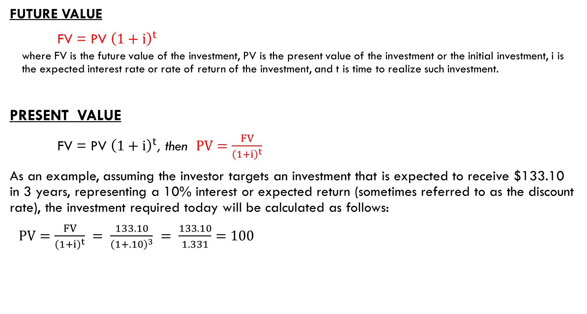
One-Time Investment
FUTURE VALUE
FV = PV ${\left(1+i\right)}^{t}$
  where FV is the future value of the investment, PV is the present value of the investment or the initial investment, i is the expected interest rate or rate of return of the investment, and t is time to realize such investment.
  PRESENT VALUE
FV = PV ${\left(1+i\right)}^{t}$, then $PV=\frac{FV}{{\left(1+i\right)}^{t}}$
As an example, assuming the investor targets an investment that is expected to receive $133.10 in 3 years, representing a 10% interest or expected return (sometimes referred to as the discount rate), the investment required today will be calculated as follows:
$PV=\frac{FV}{{\left(1+i\right)}^{t}} = \frac{133.10}{{\left(1+.10\right)}^{3}} = \frac{133.10}{1.331}=100$

Slide 63
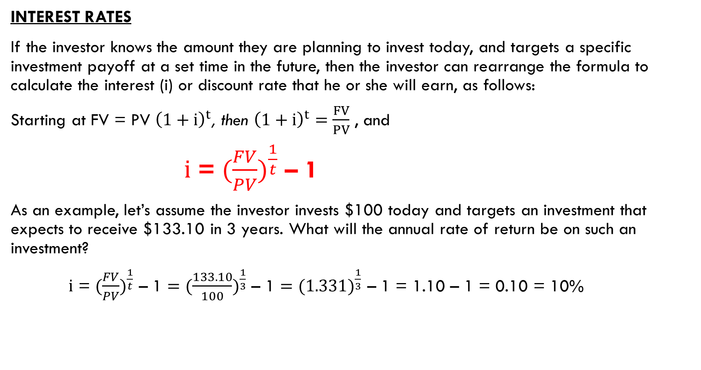
One-Time Investment
INTEREST RATES
If the investor knows the amount they are planning to invest today, and targets a specific investment payoff at a set time in the future, then the investor can rearrange the formula to calculate the interest (i) or discount rate that he or she will earn, as follows:
Starting at FV = PV ${\left(1+i\right)}^{t}$, then ${\left(1+i\right)}^{t}=\frac{FV}{PV}$ , and
$i$ = $({\frac{FV}{PV})}^{\frac{1}{t}}$ – 1
As an example, let’s assume the investor invests $100 today and targets an investment that expects to receive $133.10 in 3 years. What will the annual rate of return be on such an investment?
$i$ = $({\frac{FV}{PV})}^{\frac{1}{t}}$ – 1 $=({\frac{133.10}{100})}^{\frac{1}{3}}$ – 1 $=({1.331)}^{\frac{1}{3}}$ – 1 = 1.10 – 1 = 0.10 = 10%

Slide 64
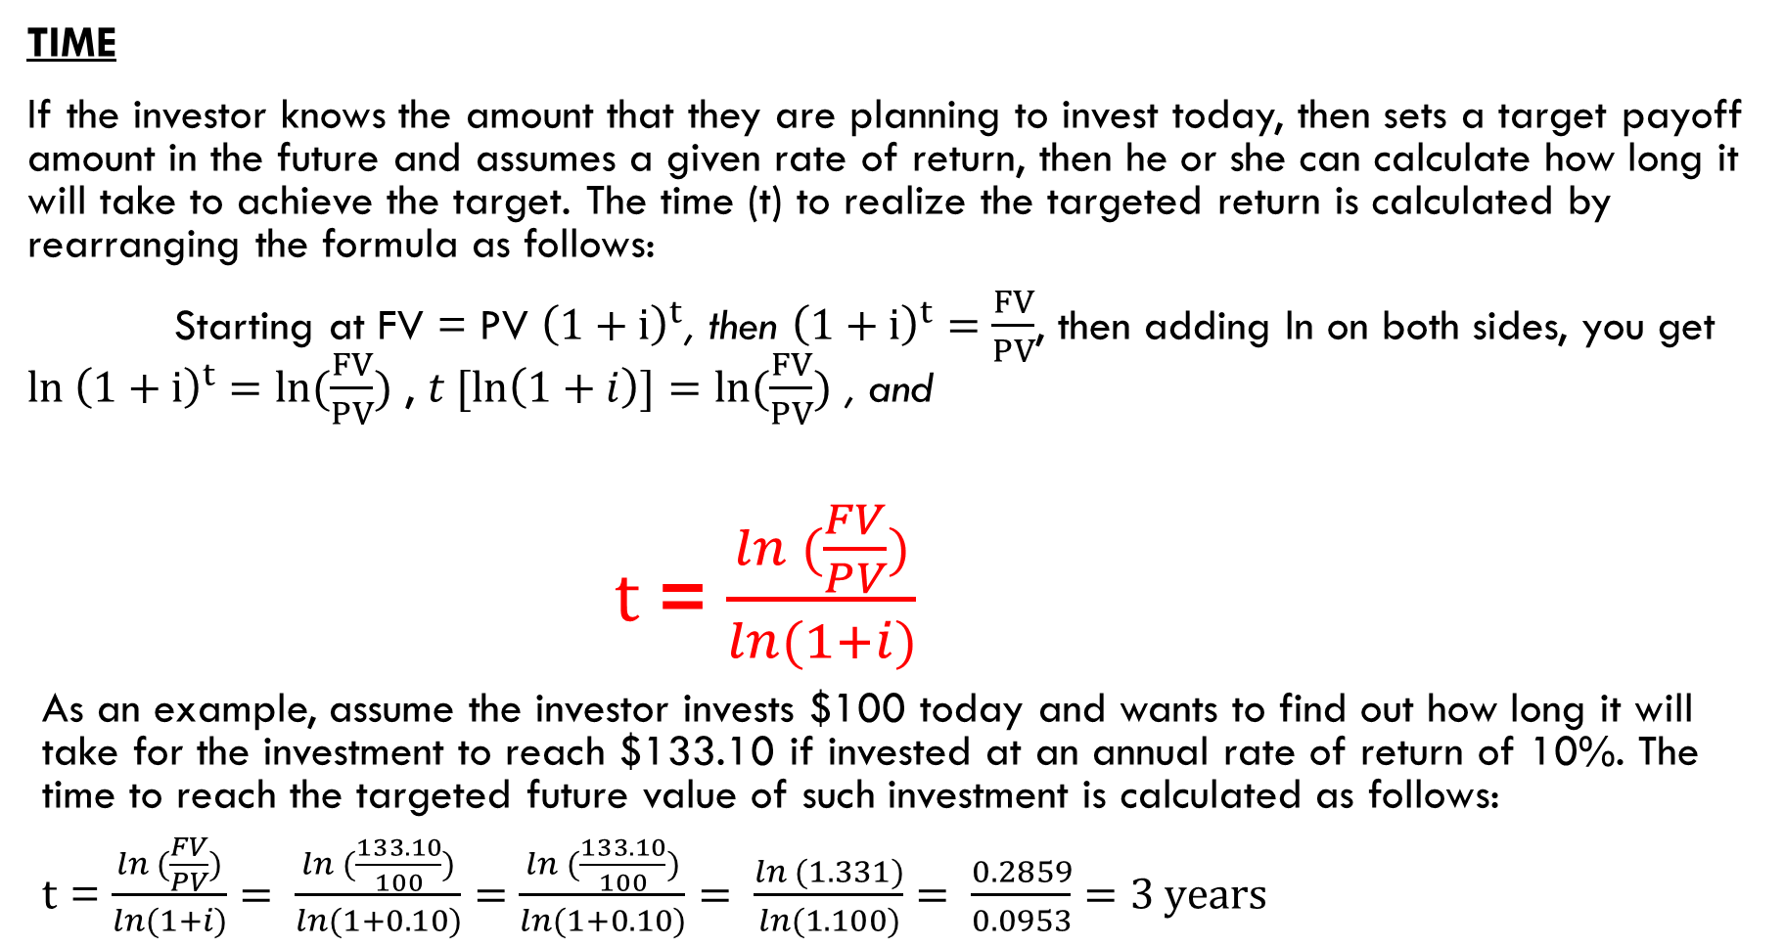
One-Time Investment
TIME
If the investor knows the amount that they are planning to invest today, then sets a target payoff amount in the future and assumes a given rate of return, then he or she can calculate how long it will take to achieve the target. The time (t) to realize the targeted return is calculated by rearranging the formula as follows:
Starting at FV = PV ${\left(1+i\right)}^{t}$, then ${\left(1+i\right)}^{t}=\frac{FV}{PV}$, then adding ln on both sides, you get ${ln \left(1+i\right)}^{t}=ln(\frac{FV}{PV})$ , $t [\ln\left(1+i\right)]=ln(\frac{FV}{PV})$ , and
$t$ = $\frac{ln (\frac{FV}{PV})}{ln⁡(1+i)}$
As an example, assume the investor invests $100 today and wants to find out how long it will take for the investment to reach $133.10 if invested at an annual rate of return of 10%. The time to reach the targeted future value of such investment is calculated as follows:
$t$ = $\frac{ln (\frac{FV}{PV})}{ln⁡(1+i)}= \frac{ln (\frac{133.10}{100})}{ln⁡(1+0.10)}=\frac{ln (\frac{133.10}{100})}{ln⁡(1+0.10)}= \frac{ln (1.331)}{ln⁡(1.100)}= \frac{0.2859}{0.0953}=3 years$

Slide 65
Excel based formulas:
Excel formulas for calculating all five variables including the present value, future value, rate of return, time and cash flows or payments (represent set additional payments received during the investment):
= PV (rate, years, payment, future value) or =pv(rate,nper,pmt,fv)
=FV (rate, years, payment, -present value) or =fv(rate,nper,pmt,pv)
=Rate (years, payment, - present value, future value) or =rate(nper,pmt,pv,fv)
=Nper (rate, payment, - present value, future value) or =nper(rate,pmt,pv,fv)

Slide 66
Annuities
Annuity – a finite series of equal payments that occur at regular intervals
Examples

Slide 67

Drawing Timelines
$100 lump sum due in 2 years
0
1
2
I%
100
3 year $100 ordinary annuity
0
1
2
3
I%
100
100
100

Slide 68
FV of an Ordinary Annuity - Example
How much will an ordinary annuity be worth in 3 years, if it pays $100 per year and earns 10% annual interest?
100 , 100 , 100
FV = ? 100 (1.1)^2 + 100 (1.1) + 100 = 331

Slide 69
FV of an Ordinary Annuity - Example
How much will an ordinary annuity be worth in 3 years, if it pays $100 per year and earns 10% annual interest?

Slide 70
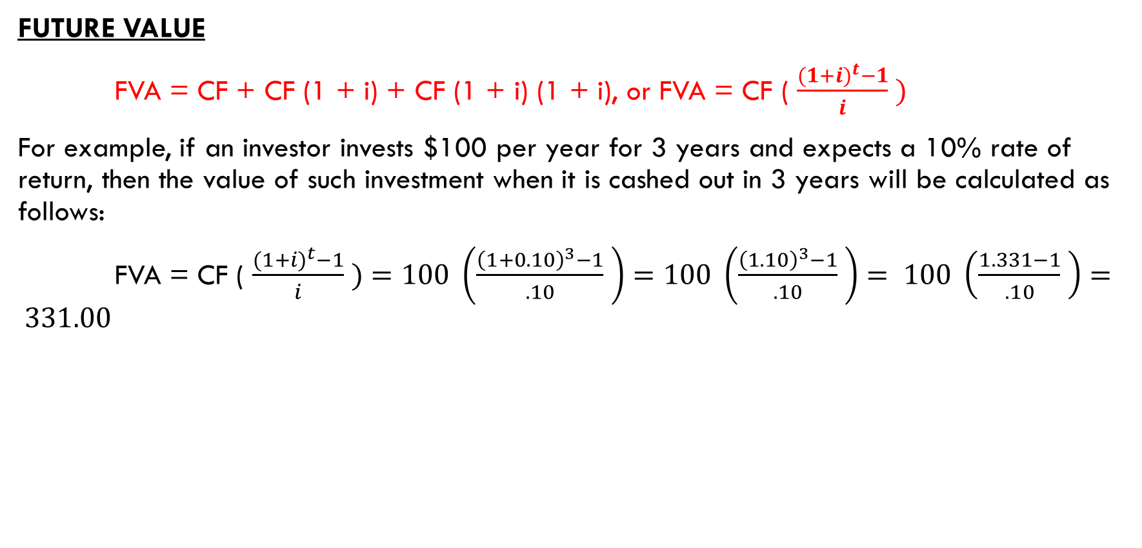
Annuities or Even Annual Cash flows
FUTURE VALUE
FVA = CF + CF (1 + i) + CF (1 + i) (1 + i), or FVA = CF ( $\frac{{(1+i)}^{t}−1}{i} )$
For example, if an investor invests $100 per year for 3 years and expects a 10% rate of return, then the value of such investment when it is cashed out in 3 years will be calculated as follows:
FVA = CF ( $\frac{{(1+i)}^{t}−1}{i} )=100 \left(\frac{{\left(1+0.10\right)}^{3}−1}{.10} \right)=100 \left(\frac{{\left(1.10\right)}^{3}−1}{.10} \right)= 100 \left(\frac{1.331−1}{.10} \right)= 331.00$

Slide 71
FV of an Ordinary Annuity: Formula

Slide 72
FV of an Ordinary Annuity - Example
How much will an ordinary annuity be worth in 3 years, if it pays $100 per year and earns 10% interest? (Use the formula)
CF = 100, t = 3 years , FV =
I = 10%, PV = 0
FV = CF ((1+i)^t ) -1 ) / r
FV = 100 ((1+i)^2 – 1) / 0.10
FV = 331

Slide 73
FV of an Ordinary Annuity - Example

Slide 74
Annuity (Real-world) Example
You decide that starting when you are 20 years old you will save $3 a day for retirement. Every day you put $3 in a drawer. At the end of the year, you invest the accumulated savings ($1,095) in a brokerage account with an expected annual return of 12%. If you continue the practice every year until you are 65, how much money will you have?

Slide 75
Annuity (Real-world) Example
You decide that starting when you are 20 years old you will save $3 a day for retirement. Every day you put $3 in a drawer. At the end of the year, you invest the accumulated savings ($1,095) in a brokerage account with an expected annual return of 12%. If you continue the practice every year until you are 65, how much money will you have?
CF = 10,095 , FV = ? , T= 45 years, PV = 0
FV = CF ((1+r)^t – 1) / r
FV = 1095 ((1+.12)^45 – 1 / .12
$1,487,261.89

Slide 76
More Examples
If you invest $100 at 5% interest how much money will you have in 8 years?
If you invest $100 per year at 5% interest, how much money will you have in 8 years?

Slide 77
More Examples
If you invest $100 at 5% interest how much money will you have in 8 years?
FV = PV (1+r)^t = 100 (1.05)^8 = $147.75
If you invest $100 per year at 5% interest, how much money will you have in 8 years?
FV = CF [ ((1+i)^t) – 1 ]/ r = 100 ((1.05)^8 – 1) / 0.05 = $954.91

Slide 78
Annuity - Cash Flow
If you would like to have $120,000 in your child’s college account in in 18 years and you can earn 6.5% per year, how much must you invest each year?

Slide 79
Who wants to be a millionaire?
How much money do you need to save each year to be a millionaire by the time you are 65 if you can earn an interest rate of 8% and you start saving when you are
20 years old:
30 years old:
40 years old
When you are born

Slide 80
Who wants to be a millionaire?
How much money do you need to save each year to be a millionaire by the time you are 65 if you can earn an interest rate of 8% and you start saving when you are
  45? $21,852.21
  30? $5,803.26
  20? $2,587.28
  Born? $541.35
  FV=$1 mm
  PV = 0
  t =65-45 = 20 years
  R = 8.0%
  =pmt(

Slide 81
Annuity - Time
You want to buy a $40,000 antique car. If you contribute $1200 per year to a savings account which earn 11% interest how long will it take before you can buy the car?

Slide 82
Number of Periods: Using Excel
Type the formula
Use a dialogue box
  Click on Formulas > Financial > NPER.
  Fill in the Rate, periodic payments (Pmt), present value (pv), and future value (Fv). Click OK.
Type the function
  =NPER(rate, pmt, pv, fv, type)

Slide 83
Annuity - Time
You want to buy a $40,000 antique car. If you contribute $1200 per year to a savings account which earn 11% interest how long will it take before you can buy the car?

Slide 84
Annuity - Time
You want to buy a $40,000 antique car. If you contribute $1200 per year to a savings account which earn 11% interest how long will it take before you can buy the car?
t= ? 14.75 years

Slide 85
Annuity – Interest rate
What interest rate must you earn in order to have $500,000 in a savings account in 20 years in you contribute $2400 per year?

Slide 86
Annuity – Interest rate
What interest rate must you earn in order to have $500,000 in a savings account in 20 years in you contribute $2400 per year?
R = ? , PV = o, FV = $500,000 , t=20 , CF = $2,400
FV = CF (I1+r)^t – 1) / r
USE EXCEL
20.90%

Slide 87
Discount Rate: Using Excel
Type the formula
Use a dialogue box
  Click on Formulas > Financial > RATE.
  Fill in the, number of periods (Nper), periodic payments (Pmt), present value (pv), and future value (Fv). Click OK.
Type the function
  = RATE(nper, pmt, pv, fv, type, guess)

Slide 88
Annuity – Interest rate
HPR vs Interest Rate same as IRR
What interest rate must you earn in order to have $500,000 in a savings account in 20 years in you contribute $2400 per year?
=Rate (nper, pmt, pv, fv, type, guess)
20.90%

Slide 89
Present Value of an Annuity
How much is an ordinary annuity currently worth, if it pays $100 per year for 3 years and earns 10% interest?
$248.68 = 100 /(1.1)^1 + 100 / (1.1)^2 + 100 / (1.1)^3 =
Cf / (1+r)^1, CF /(1+r)^2

Slide 90
PV of an Annuity: Formula

Slide 91
PV of an Ordinary Annuity - Example
How much is an ordinary annuity currently worth, if it pays $100 per year for 3 years and earns 10% interest? (Use the formula)
PV = CF (1 – ( (1 / (1+r) ^ t)) / r
PV = 100 (1 – (1/(1+.1)^3 ) / 0.10
PV = $248.68

Slide 92
Present Value of an Annuity
How large a mortgage can you get if you can afford payments of $8000 per year for the next 30 years and the interest rate is 4.68%?

Slide 93
PV: Using Excel Technology
Type the formula
Use a dialogue box
  Click on Formulas > Financial > PV.
  Fill in the Rate, number of periods (Nper), periodic payments (Pmt), and future value (Fv). Click OK.
Type the function
  =PV(rate, nper, pmt, fv, type)

Slide 94
Retirement
After you retire, you want to withdraw $50,000 a year from your savings account which earns 4% annual interest for 30 years. How much money do you need in your saving account when you retire?

Slide 95
Annuity – Time
If you borrow $60,000 in student loans at an interest rate of 7.5% and you can afford to pay $4,800 per year how long will it take you to pay off your loans?

Slide 96
Annuity – Interest rate
At retirement you have $750,000 in your savings account. You intend to withdraw $65,000 per year. What interest rate must you earn to make your money last for the next 30 years?
PV = $750,000, PMT = $65,000, t = 30, FV = 0, r = ?
Rate = ? = 7.74%

Slide 97
Annuity - Recap
An annuity is a financial security which consists of a finite series of equal payments that occur at regular intervals.
You can find the future value of an annuity by:
  Adding the future values of each payment.
  Using the formula.
  Using Excel.

Slide 98
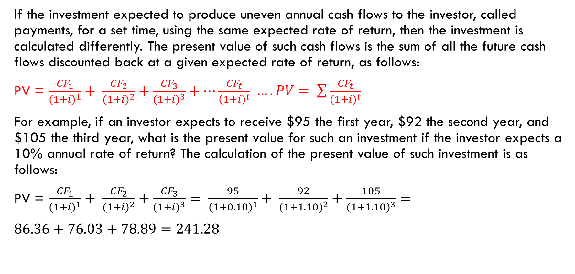
Uneven Annual Cash Flows
If the investment expected to produce uneven annual cash flows to the investor, called payments, for a set time, using the same expected rate of return, then the investment is calculated differently. The present value of such cash flows is the sum of all the future cash flows discounted back at a given expected rate of return, as follows:
PV = $\frac{{CF}_{1}}{{(1+i)}^{1}}+ \frac{{CF}_{2}}{{(1+i)}^{2}}+\frac{{CF}_{3}}{{(1+i)}^{3}}+…\frac{{CF}_{t}}{{\left(1+i\right)}^{t}} …. PV= \sum{\frac{{CF}_{t}}{{(1+i)}^{t}}}$
For example, if an investor expects to receive $95 the first year, $92 the second year, and $105 the third year, what is the present value for such an investment if the investor expects a 10% annual rate of return? The calculation of the present value of such investment is as follows:
PV = $\frac{{CF}_{1}}{{(1+i)}^{1}}+ \frac{{CF}_{2}}{{(1+i)}^{2}}+\frac{{CF}_{3}}{{(1+i)}^{3}}= \frac{95}{{(1+0.10)}^{1}}+ \frac{92}{{(1+1.10)}^{2}}+\frac{105}{{(1+1.10)}^{3}}=$
$86.36+76.03+78.89=241.28$

Slide 99
Excel based formulas:
Excel formulas for calculating all five variables including the present value, future value, rate of return, time and cash flows or payments (represent set additional payments received during the investment):
= PV (rate, years, payment, future value) or =pv(rate,nper,pmt,fv)
=FV (rate, years, payment, -present value) or =fv(rate,nper,pmt,pv)
=Rate (years, payment, - present value, future value) or =rate(nper,pmt,pv,fv)
=Nper (rate, payment, - present value, future value) or =nper(rate,pmt,pv,fv)
= Pmt (rate, years, -present value, future value) or =pmt(rate,nper,pv,fv)

Slide 100
Measuring Return and Return Expectation
Before you invest your money in any securities or any businesses, it’s extremely important to consider and must measure the following four factors:
  Return expectation
  Risk
  Allocation
  Time

Slide 101
Objective of Return and Return Expectation
As discussed previously, it is essential to measure the historical returns of a particular asset class and then set an expectation going forward based on various methods that we will examine in this section. The return analysis objectives are as follows:
  Trend Analysis: To compare the return analysis to historical trends of the particular investment, project the trend going forward, and adjust such trends based on views for driving such investment
  Comparative Analysis: To compare it to other asset classes and/or the market, and/or the risk-free rate.
  Expectation Analysis: To compare it to last year’s expectations and continue to test the performance versus expectation

Slide 102
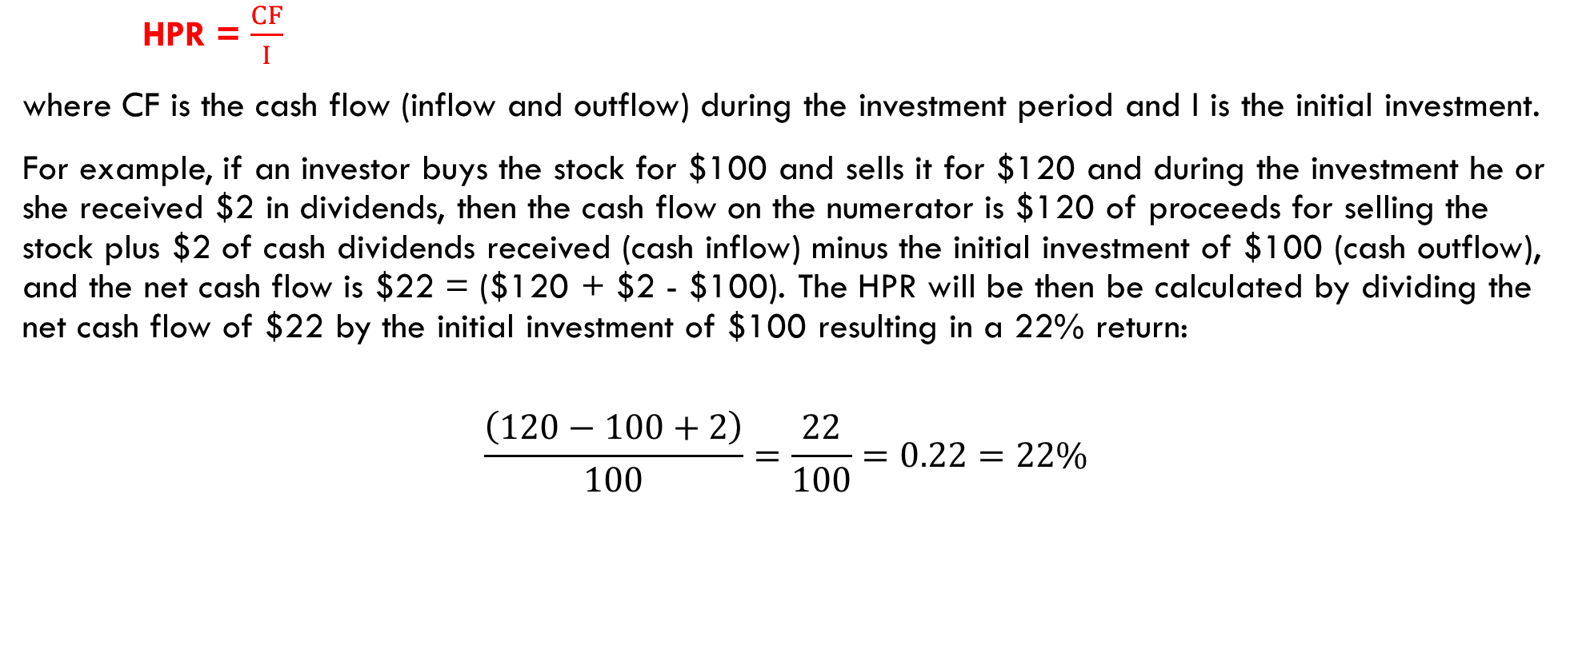
Rates of Return: Holding Period Return (HPR)
HPR = $\frac{CF}{I}$
where CF is the cash flow (inflow and outflow) during the investment period and I is the initial investment.
For example, if an investor buys the stock for $100 and sells it for $120 and during the investment he or she received $2 in dividends, then the cash flow on the numerator is $120 of proceeds for selling the stock plus $2 of cash dividends received (cash inflow) minus the initial investment of $100 (cash outflow), and the net cash flow is $22 = ($120 + $2 - $100). The HPR will be then be calculated by dividing the net cash flow of $22 by the initial investment of $100 resulting in a 22% return:
$$\frac{\left(120−100+2\right)}{100}=\frac{22}{100}=0.22=22\%$$

Slide 103
Rates of Return:
Annual Rate of Return (ROR) and Internal Rate of Return (IRR)
The more challenging calculation is if the payment is different every year, so the annual rate of return must be weighted based on size and the year paid sometime referred to as dollar weighted return. This type of rate return method is the internal rate of return. It’s challenging because each year the investment would have different payoffs and sometimes negative numbers. The best approach to calculate the IRR is using spreadsheet analysis. The formula on excel is as follows:
=IRR(CF₀, CF₁, CF₂, CF₃ . . . CF_{t}).

Slide 104
INTERNAL RATE OF RETURN
HPR = CF / investment bought the stock at 100 sold it 120 = what’s your return
(120-100)/100 = 20/100 = 20%
Bought 100, received a div $4 sold at 120 = HPR?
(120-100+4) / 100 = (20 + 4 )/100 = 24/100 = .24 = 24%

Slide 105
HISTORICAL RETURN ANALYSIS

Slide 106
SCENARIO analysis

