Slide 1
Topic 14: Conduct of Monetary Policy: Tools, Goals, Strategy, and Tactics
Main Reading (Sources): Chap 10 Mishkin & Eakins, 8th

Slide 2
Chapter Preview
How Fed Actions Affect Reserves in the Banking System
The Market for Reserves and the Federal Funds Rate
Conventional Monetary Policy Tools
Nonconventional Monetary Policy Tools and Quantitative Easing
Monetary Policy Tools of the ECB
The Price Stability Goal and the Nominal Anchor
Other Goals of Monetary Policy
Should Price Stability be the Primary Goal of Monetary Policy?
Inflation Targeting
Should Central Banks Respond to Asset-Price Bubbles? Lessons from the Global Financial Crisis

Slide 3
How Fed Actions Affect Reserves in the Banking System (1 of 2)
All banks have an account at the Fed in which they hold deposits. Reserves consist of deposits at the Fed plus currency that is physically held by banks.
Reserves are divided into two categories:
Required reserves
Excess reserves

Slide 4
How Fed Actions Affect Reserves in the Banking System (2 of 2)
The Fed sets the required reserve ratio – the portion of deposits banks must hold in cash. Any reserves deposited with the Fed beyond this amount are excess reserves.
The Fed injects reserves into the banking system in two ways:
Open market operations
Loans to banks, referred to as discount loans.

Slide 5
Open Market Operations
We will examine the impact of open market operations conducted through primary dealers. We will show the following:
Purchase of bonds increases the money supply
Making discount loans increases the money supply
Naturally, the Fed can decrease the money supply by reversing these transactions.

Slide 6
The Federal Reserve Balance Sheet (1 of 2)
Open Market Purchase from Primary Dealer
Banking System | Blank
Assets | Liabilities
Securities | Blank
–$100 m | Blank
Reserves | Blank
+$100 m | Blank
The Fed | Blank
Assets | Liabilities
Securities | Reserves
+$100 m | +$100 m
Result R ↑ $100, MB $100

Slide 7
The Federal Reserve Balance Sheet (2 of 2)
Discount Lending
Banking System | Blank
Assets | Liabilities
Reserves | Loans
+$100 m | +$100 m
The Fed | Blank
Assets | Liabilities
Discount loans | Reserves
+$100 m | +$100 m
Result R ↑ $100, MB $100

Slide 8
The Market for Reserves and the Federal Funds Rate
We will now examine how this change in reserves affects the federal funds rate, the rate banks charge each other for overnight loans.

Slide 9
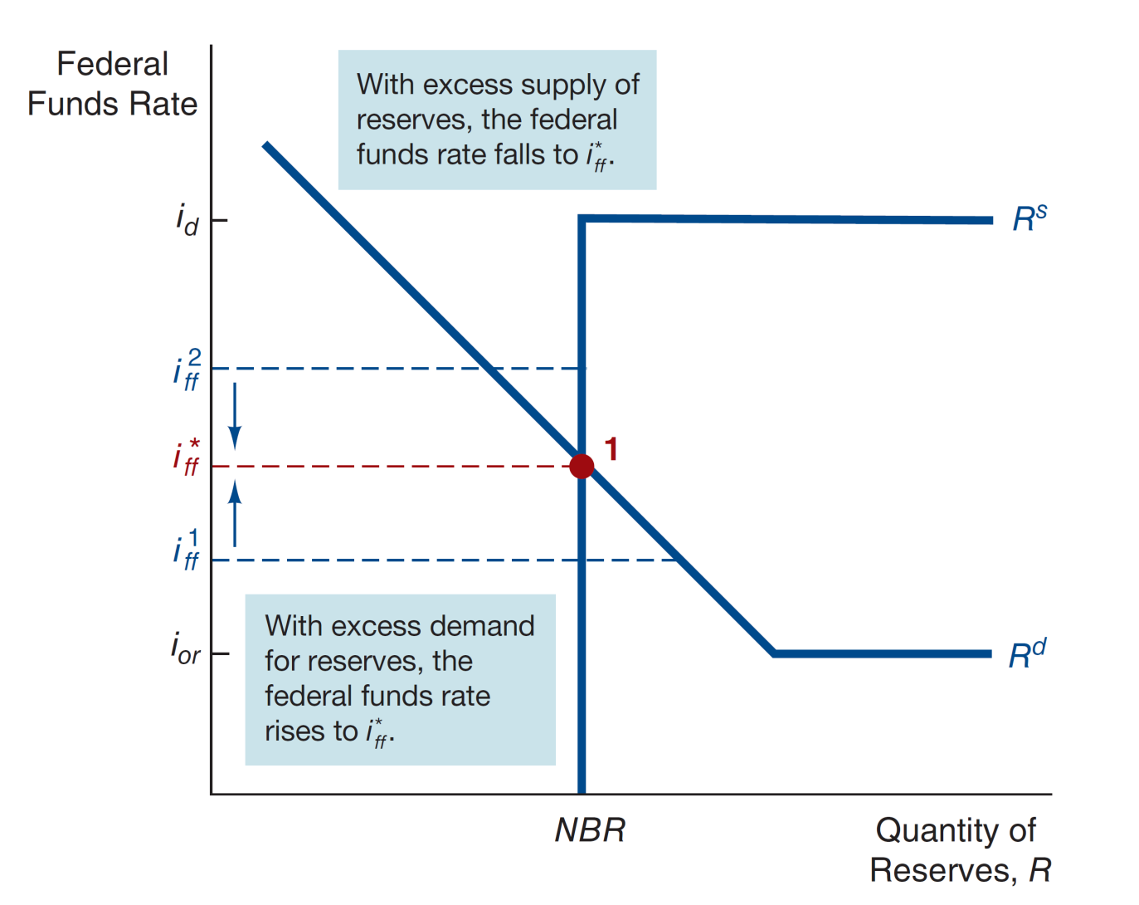
Figure 10.1 Equilibrium in the Market for Reserves

Slide 10
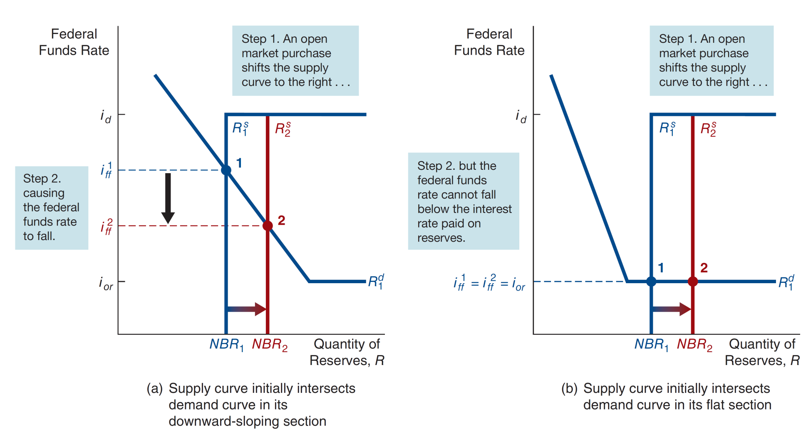
Figure 10.2 Response to Open Market Operations

Slide 11
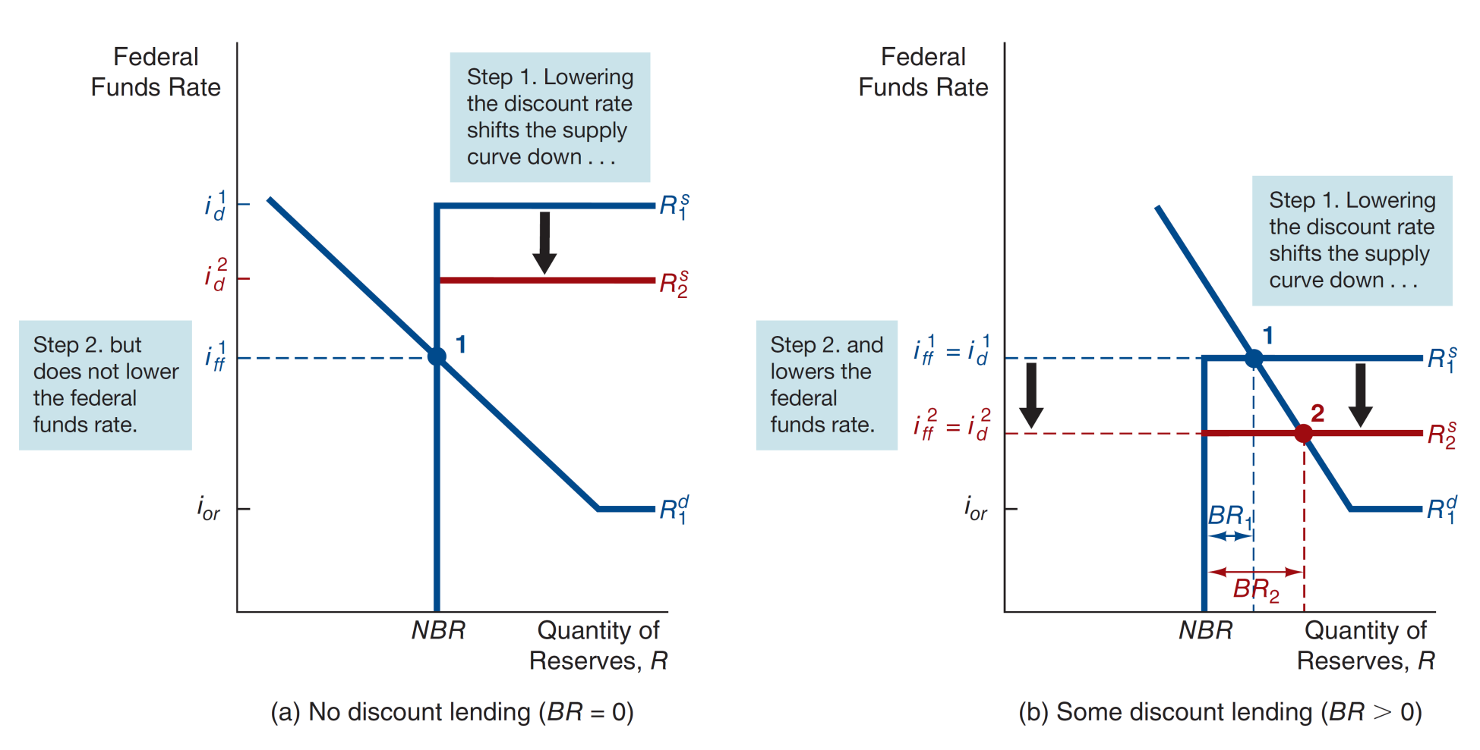
Figure 10.3 Response to Change in Discount Rate

Slide 12
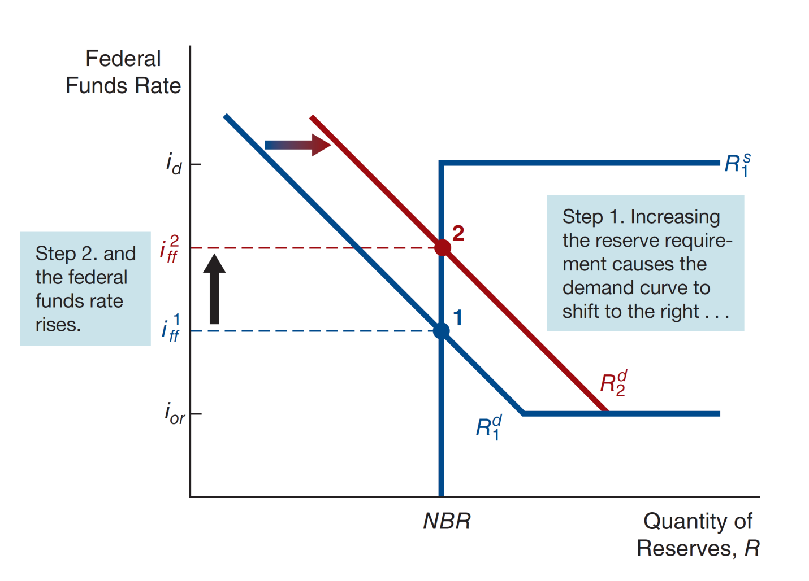
Figure 10.4 Response to Change in Required Reserves

Slide 13
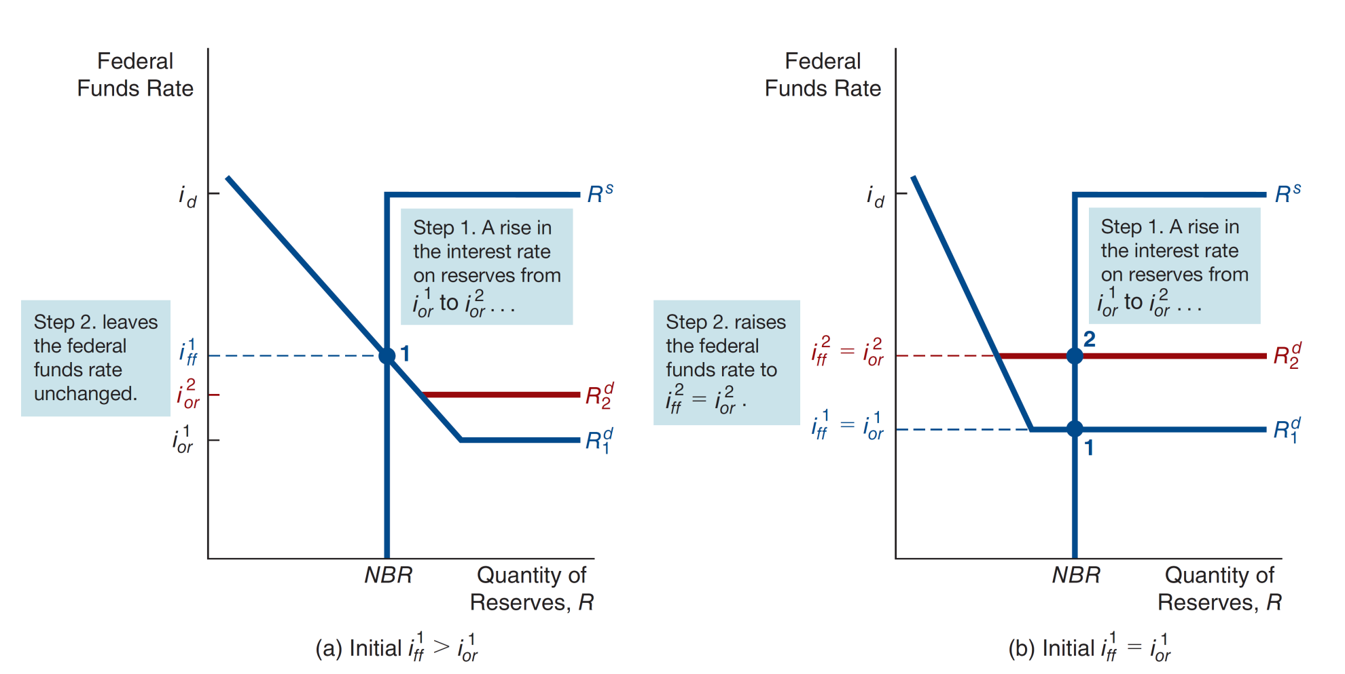
Figure 10.5 Response to Change in the interest Rate on Reserve

Slide 14
Case: How Operating Procedures Limit Fluctuations in Fed Funds Rate
Changes in the demand for reserves will not affect the fed funds rate - borrowed reserves will increase to match the demand!
This is true whether the demand increases, or decreased.

Slide 15
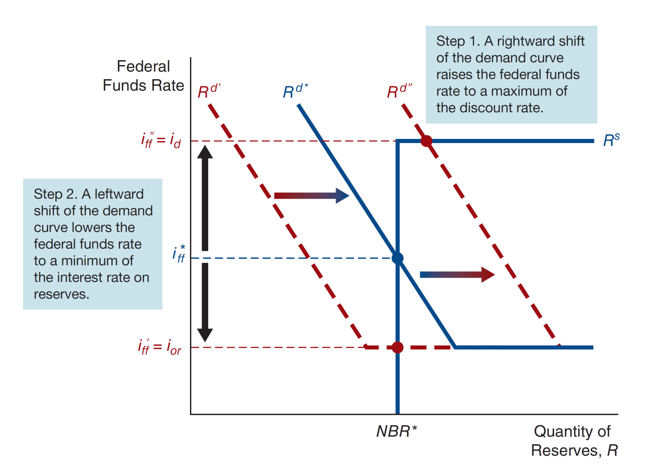
Figure 10.6 How Operating Procedures Limit Fluctuations in Fed Funds Rate

Slide 16
Tools of Monetary Policy: Open Market Operations
Open Market Operations
Dynamic: Change reserves and monetary base
Defensive: Offset factors affecting reserves, typically uses repos
Advantages of Open Market Operations
Fed has complete control
Flexible and precise
Easily reversed
Implemented quickly

Slide 17
Inside the Fed: A Day at the Trading Desk (1 of 2)
The staff reviews the activities of the prior day and issue forecasts of factors affecting the supply and demand for reserves.
This information is used to determine reserve changes needed to obtain a desired fed funds rate.
Government securities dealers are contacted to better determine the condition of the market.
Projections are compared with the Monetary Affairs Division of the BOG, and a course of action is determined.
Once the plan is approved, the desk carries out the required trades, via the TRAPS system.

Slide 18
Inside the Fed: A Day at the Trading Desk (2 of 2)
The trading desk typically uses two types of transactions to implement their strategy:
Repurchase agreements: the Fed purchases securities, but agrees to sell them back within about 15 days. So, the desired effect is reversed when the Fed sells the securities back—good for taking defense strategies that will reverse.
Matched sale-purchase transaction: essentially a reverse repro, where the Fed sells securities, but agrees to buy them back.

Slide 19
Tools of Monetary Policy: Discount Policy (1 of 3)
The Fed’s discount loans, through the discount window, are:
Primary Credit: Healthy banks borrow as they wish from the primary credit facility or standing lending facility.
Secondary Credit: Given to troubled banks experiencing liquidity problems.
Seasonal Credit: Designed for small, regional banks that have seasonal patterns of deposits.

Slide 20
Tools of Monetary Policy: Discount Policy (2 of 3)
Lender of Last Resort Function
To prevent banking panics
Example: Continental Illinois
Really needed? What about the FDIC?
Problem 1: FDIC only has about 1% of deposits in the insurance trust
Problem 2: over $1.1 trillion are large deposits not insured by the FDIC

Slide 21
Tools of Monetary Policy: Discount Policy (3 of 3)
Lender of Last Resort Function
Can also help avoid panics
Ex: Market crash in 1987 and terrorist attacks in 2001 - bad events, but no real panic in our financial system
But there are costs!
Banks and other financial institutions may take on more risk (moral hazard) knowing the Fed will come to the rescue

Slide 22
Tools of Monetary Policy: Reserve Requirements
Reserve Requirements are requirements put on financial institutions to hold liquid (vault) cash again checkable deposits.
Everyone subject to the same rule for checkable deposits:
3% of first $48.3M, 10% above $48.3M
Fed can change the 10%
Rarely used as a tool
Raising causes liquidity problems for banks
Makes liquidity management unnecessarily difficult

Slide 23
Nonconventional Monetary Policy Tools and Quantitative Easing
The Global Financial Crisis challenged the Fed’s ability to stabilize the economy:
Financial system seized
Zero-lower-bound problem – could take rates below zero
The problems called for the use of nonconventional tools.

Slide 24
Liquidity Provisions
Discount windows expansion – discount rate lowered several times.
Term auction facility – another loan facility, offering another $400 billion to institutions.
New lending programs – included lending to IBs, and lending to promote purchase of asset-backed securities.

Slide 25
Fed Lending Facilities During the Global Financial Crisis (1 of 3)
Lending Facility | Date of Creation | Function
Term Auction Facility (TAF) | December 12, 2007 | To make borrowing from the Fed more widely used; extends loans of fixed amounts to banks at interest rates that are determined by competitive auction rather than being set by the Fed, as with normal discount lending
Term Securities Lending Facility (TSLF) | March 11, 2008 | To provide sufficient Treasury securities to act as collateral in credit markets; lends Treasury securities to primary dealers for terms longer than overnight against a broad range of collateral
Swap Lines | March 11, 2008 | Lends dollars to foreign central banks in exchange for foreign currencies so that these central banks can in turn make dollar loans to their domestic banks

Slide 26
Fed Lending Facilities During the Global Financial Crisis(2 of 3)
Lending Facility | Date of Creation | Function
Loans to J.P. Morgan to buy Bear Stearns | March 14, 2008 | Bought $30 billion of Bear Stearns assets through nonrecourse loans to J.P. Morgan to facilitate its purchase of Bear Stearns
Primary Dealer Credit Facility (PDCF) | March 16, 2008 | Lends to primary dealers (including investment banks) so that they can borrow on similar terms to banks using the traditional discount window facility
Loans to AIG | September 16, 2008 | Loaned $85 billion to AIG

Slide 27
Fed Lending Facilities During the Global Financial Crisis (3 of 3)
Lending Facility | Date of Creation | Function
Commercial Paper Funding Facility (CPFF) | October 7, 2008 | Finances purchase of commercial paper from issuers
Money Market Investor Funding Facility (MMIFF) | October 21, 2008 | Lends to special-purpose vehicles so that they can buy a wider range of money market mutual fund assets
Term Asset-Backed Securities Loan Facility (TALF) | November 25, 2008 | Lends to issuers of asset-backed securities against these securities as collateral to improve functioning of this market

Slide 28
Large-Scale Asset Purchases (Quantitative Easing)
Nov 2008 – QE1 established, purchasing $1.25 trillion in MBSs.
Nov 2010 – QE2, Fed purchases $600 billion in Treasuries, lower long-term rates.
Sept 2012 – QE3, Fed commits to buying $40 billion in MBSs each month.

Slide 29
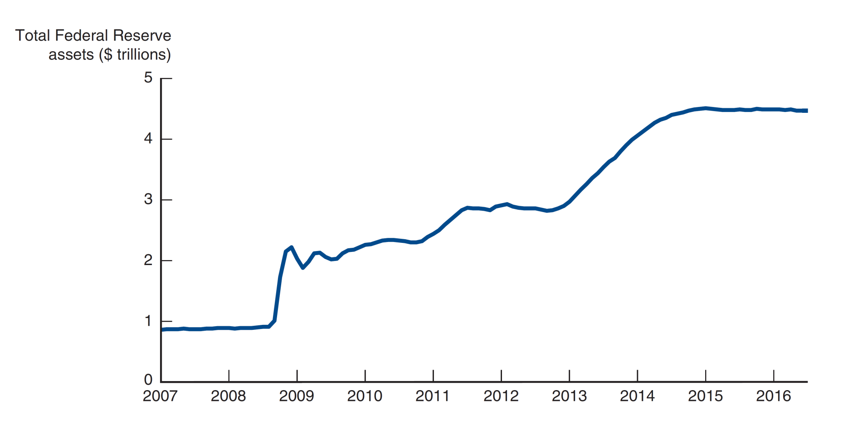
Figure 10.7 Total Federal Reserve Assets, 2007 – 2016
Source: Federal Reserve Bank of St. Louis, FRED database: https://fred.stlouisfed.org/series/WALCL#0.

Slide 30
Quantitative Easing vs. Credit Easing (1 of 2)
Quantitative Easing v. Credit Easing
However, short-term rate is already near zero – not clear further action helps.
Banks are not lending
Money supply did not expand

Slide 31
Quantitative Easing vs. Credit Easing (2 of 2)
Fed Chairman Ben Bernanke argues that the Fed has been engaged in credit easing, actions to impact credit markets.
How does this work?
Liquidity can help unfreeze markets that have seized.
Asset purchases can lower rates on those assets, focusing on specific markets.

Slide 32
Forward Guidance (1 of 2)
By committing to maintain short-term rates near zero, future short-term rates should also be zero, meaning long-term rates fall.
This is known as forward guidance.
Fed started this policy in late 2008, committing to hold rates low through mid-2015.
Long rates fell, although cause not clear.

Slide 33
Forward Guidance (2 of 2)
Commitment to low fed funds rate is conditional, predicated on weak economy.
Could make an unconditional commitment to keep rates low, regardless of the economy.
However, unconditional commitments can be tough, especially if circumstances change. Becomes a credibility problem.
2003 experience confirmed this – Fed’s unconditional commitment of low rates needed to change.
With the unemployment rate over 6%, at its March 2014 meeting the FOMC dropped forward guidance based on unemployment and inflation thresholds.

Slide 34
Negative Interest Rates on Banks’ Deposits (1 of 2)
Central banks in Europe and Japan have started experimenting with charging banks negative interest rates on deposits held at the central bank.
Sweden - 2009, Denmark – 2012, etc.
Supposed to encourage banks to lend, as opposed to holding deposits.

Slide 35
Negative Interest Rates on Banks’ Deposits (2 of 2)
Banks could just hold cash instead of depositing money with the central bank. But the costs of that (vaults, guards, security systems) is high.
Lower profitability might lead to banks to lend less.
Results not clear. The U.S. Fed announced that it would not use negative interest rates as a tool.

Slide 36
Monetary Policy Tools of the European Central Bank
ECB policy signals by
setting a target financing rate,
which establishes the overnight cash rate.
The EBC has tools to implement its intended policy: (1) open market operations, (2) lending to banks, and (3) reserve requirements.

Slide 37
ECB Open Market Operations
Like the Fed, open market operations are the primary tool to implement the policy.
The ECB primarily uses main refinancing operations (like repos) via a bid system from its credit institutions.
Operations are decentralized—carried out by each nation’s central bank.
Also engage in long-term refinancing operations, but not really to implement policy.

Slide 38
ECB Lending to Banks
Like the Fed, the ECB lends to its member banks via its marginal lending facility.
Banks can borrow at the marginal lending rate, which is 100 basis points above the target lending rate.
Also has the deposit facility. This provides a floor for the overnight market interest rate.

Slide 39
ECB Interest on Reserves
Like the Fed, ECB has a deposit facility, where banks can store excess cash and earn interest.
As previously discussed, the interest rate is not always positive (negative starting in July 2014).
Like the Fed, ECB requires banks to hold 2% of checkable deposits, plus a minimum reserve requirement.
The ECB does pay interest on reserves.

Slide 40
Price Stability Goal & the Nominal Anchor (1 of 3)
Policymakers have come to recognize the social and economic costs of inflation.
Price stability, therefore, has become a primary focus.
High inflation seems to create uncertainty, hampering economic growth.
Indeed, hyperinflation has proven damaging to countries experiencing it.

Slide 41
Price Stability Goal & the Nominal Anchor (2 of 3)
Policymakers must establish a nominal anchor which defines price stability. For example, “maintaining an inflation rate between 2% and 4%” might be an anchor.
An anchor also helps avoid the time-inconsistency problem.

Slide 42
Price Stability Goal & the Nominal Anchor (3 of 3)
The time-inconsistency problem is the idea that day-by-day policy decisions lead to poor long-run outcomes.
Policymakers are tempted in the short-run to pursue expansionary policies to boost output. However, just the opposite usually happens.
Central banks will have better inflation control by avoiding surprise expansionary policies.
A nominal anchor helps avoid short-run decisions.

Slide 43
Other Goals of Monetary Policy
Goals
High employment
Want demand = supply, or natural rate of unemployment
Economic growth (natural rate of output)
Stability of financial markets
Interest-rate stability
Foreign exchange market stability
Goals often in conflict

Slide 44
Should Price Stability be the Primary Goal? (1 of 2)
Price stability is not inconsistent with the other goals in the long-run.
However, there are short-run trade-offs.
An increase in interest rates will help prevent inflation, but increases unemployment in the short-run.
The ECB uses a hierarchical mandate, placing the goal of price stability above all other goals.
The Fed uses a dual mandate, where “maximizing employment, stable prices, and moderate long-term interest rates” are all given equal importance.

Slide 45
Should Price Stability be the Primary Goal? (2 of 2)
Which is better?
Both hierarchical and dual mandates achieve the natural rate of unemployment. However, usually more complicated in practice.
Also, short-run inflation may be needed to maintain economic output. So, long-run inflation control should be the focus.
Dual mandate can lead to increased employment and output, but also increases long-run inflation.
Hierarchical mandate can lead to over-emphasis on inflation alone - even in the short-run.
Answer? It depends. Both help the central bank focus on long-run price stability.

Slide 46
Global: the ECB’s Strategy
The ECB pursues a hybrid monetary policy, including both monetary targeting and inflation targeting.
Two key pillars:
Monetary and credit aggregates are monitored for implications on future inflation and growth
Many other variables examined to assess the future economic outlook

Slide 47
Inflation Targeting (1 of 2)
Inflation targeting involves:
Announcing a medium-term inflation target
Commitment to monetary policy to achieve the target
Inclusion of many variables to make monetary policy decisions
Increasing transparency through public communication of objectives
Increasing accountability for missed targets

Slide 48
Inflation Targeting (2 of 2)
New Zealand
Passed the Reserve Bank of New Zealand Act (1990)
Canada
Established formal inflation targets, starting in 1991
United Kingdom
Established formal inflation targets, starting in 1992, published in Inflation
Sweden, Finland, Australia, and Spain
Followed suit in 1993 and 1994.

Slide 49
Inflation Targeting: Pros and Cons (1 of 3)
Advantages
Easily understood by the public
Helps avoid the time-inconsistency problem since public can hold central bank accountable to a clear goal
Forces policymakers to communicate goals and discuss progress regularly
Performance has been good!

Slide 50
Inflation Targeting: Pros and Cons (2 of 3)
Disadvantages
Signal of progress is delayed
Affects of policy may not be realized for several quarters.
Policy tends to promote too much rigidity
Limits policymakers ability to react to unforeseen events
Usually “flexible targeting” is implemented, focusing on several key variables and targets modified as needed

Slide 51
Inflation Targeting: Pros and Cons (3 of 3)
Disadvantages
Potential for increasing output fluctuations
May lead to a tight policy to check inflation at the expense of output, although policymakers usually pay attention to output
Usually accompanied by low economic growth
Probably true when getting inflation under control
However, economy rebounds

Slide 52
Inside the Fed: Ben Bernanke and Inflation Targeting (1 of 2)
Well-authored on the implementation and impact of inflation targeting while a professor at Princeton.
Speech in 2004 suggests the Fed will continue to move toward inflation targeting.
However, comments since taking over the Fed suggest he will look for consensus here before acting.

Slide 53
Inside the Fed: Ben Bernanke and Inflation Targeting (2 of 2)
The 2007 announcement of the new communication strategy of three year inflation projects will certainly impact the FOMC’s objectives.
In 2012, FOMC set inflation target at 2% on the PCE deflator.
Indicated this was flexible – focus on both inflation and employment.

Slide 54
Should Central Banks Respond to Asset-Price Bubbles? Lessons from the Global Financial Crisis
Asset pricing bubbles occur when
asset’s prices climb above fundamental values
… then fall back to the fundamental value (or below) quite rapidly

Slide 55
Should Central Banks Respond to Asset-Price Bubbles? (1 of 3)
What should central banks do about pricing bubbles?
Should response be different from inflation and employment goals?
Should response minimize damage when bubble bursts?
Clean-up after bubble bursts?

Slide 56
Should Central Banks Respond to Asset-Price Bubbles? (2 of 3)
To help answer this, we first must define the types of pricing bubbles.
Credit-driven bubble: created when easy credit terms spill over into asset prices. And as asset prices increase, further lending is encouraged.
Very dangerous when the bubble ends - the downward spiral can be more damaging than the asset bubble.

Slide 57
Should Central Banks Respond to Asset-Price Bubbles? (3 of 3)
To help answer this, we first must define the types of pricing bubbles.
Optimism-driven bubble: driven by overly optimistic expectations of asset pricing. Ex., the tech bubble of the late-1990s.
These bubbles are less dangerous, as the impact on the financial system is limited. Resulting wealth transfers are not good for the economy.

Slide 58
Should Central Banks Respond? (1 of 2)
The “Greenspan” doctrine for why the answer is no:
Bubbles are difficult to identify
Rate changes may do nothing
Rates are a blunt instrument - affect many asset prices in the economy
Resulting slow economy, unemployment, etc., may be worse than the bubble.
Policy reactions after the bubble bursts may keep damage at a reasonable level.

Slide 59
Should Central Banks Respond? (2 of 2)
The global financial crisis suggests the answer is yes:
Suggests leaning against credit-driven bubbles.
Seems easy to identify, but what policies are most effective?

Slide 60
Macroprudential Regulation
Macroprudential regulation may be the answer
Increase disclosure requirements and capital requirements, prompt corrective action, monitoring risk-management procedures, and close supervision.
For example, countercyclical capital requirements would dampen credit-booms. As asset prices increase, increase required capital.

Slide 61
Monetary policy (1 of 2)
Low interest rates may be the “risk-taking channel of monetary policy”
Asset managers search for high yield
Asset demand may increase
Lenders consider riskier projects
Perhaps just use macroprudential policies?

Slide 62
Monetary policy (2 of 2)
Macroprudential policies can be more difficult to enact:
Subject to political pressure
Can impact bottom line of firms
Institutions are good at finding ways around regulation
Best policy is not clear.

Slide 63
Tactics: Choosing the Policy Instrument
A policy instrument (ex., the fed funds rate) responds to the Fed’s tools. There are two basic types of instruments: reserve aggregates and short-term interest rates.
An intermediate target (for example, a long-term interest rate) is not directly affected by a Fed tool, but is linked to actual goals (e.g., long-run price stability).

Slide 64
Using a Fed Watcher
Fed watcher predicts monetary tightening, i ↑
Acquire funds at current low i
Buy $ in FX market
Fed watcher predicts monetary loosening, i ↓
Make loans now at high i
Buy bonds, price rise in future
Sell $ in FX market

Slide 65
Chapter Summary (1 of 3)
How Fed Actions Affect Reserves in the Banking System: the Fed’s actions change both its balance sheet and the money supply. Open market operations and discount loans were examined.
The Market for Reserves and the Federal Funds Rate: supply and demand analysis shows how Fed actions affect market rates.
Conventional Monetary Policy Tools: the Fed can use open market operations, discount loans, and reserve ratios to enact Fed directives.

Slide 66
Chapter Summary (2 of 3)
Nonconventional Monetary Policy Tools and Quantitative Easing: Tools the Fed used to battle the effects of the global financial crisis.
Monetary Policy Tools of the ECB: The ECB vs. the Fed on monetary policy, tools, and targets.
The Price Stability Goal and the Nominal Anchor: stable inflation has become the primarily goal of central banks, but this has pros and cons.
Other Goals of Monetary Policy: such as employment, growth, and stability, need to be considered along with inflation.

Slide 67
Chapter Summary (3 of 3)
Should Price Stability be the Primary Goal of Monetary Policy?: We outlined conditions when this goal is both consistent and inconsistent with other monetary goals.
Inflation Targeting: This policy has advantages: clear, easily understood, and keeps central bankers accountable. But is this at the cost of growth and employment?
Should Central Banks Respond to Asset Price Bubbles? In the case of credit-driven bubbles, the answer appears to be yes! But the right tool is not obvious.

